Slide 1
Intelligent Agents
Chapter 2

Slide 2
Outline
Agents and environments
Rationality
PEAS (Performance measure, Environment, Actuators, Sensors)
Environment types
Agent types

Slide 3
Agents
An agent is anything that can be viewed as perceiving its environment through sensors and acting upon that environment through actuators

Slide 4
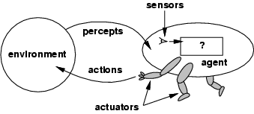
Agents and environments
The agent function maps from percept histories to actions:
[f: P* → A]
The agent program runs on the physical architecture to produce f
agent = architecture + program

Slide 5
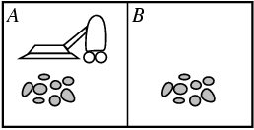
Vacuum-cleaner world
Percepts: location and contents, e.g., [A,Dirty]
Actions: Left, Right, Suck, NoOp

Slide 6
Rational agents
An agent should strive to "do the right thing", based on what it can perceive and the actions it can perform. The right action is the one that will cause the agent to be most successful
Performance measure: An objective criterion for success of an agent's behavior
E.g., performance measure of a vacuum-cleaner agent could be amount of dirt cleaned up, amount of time taken, amount of electricity consumed, amount of noise generated, etc.

Slide 7
Rational agents
Rational Agent: For each possible percept sequence, a rational agent should select an action that is expected to maximize its performance measure, given the evidence provided by the percept sequence and whatever built-in knowledge the agent has.

Slide 8
Rational agents
Rationality is distinct from omniscience
Agents can perform actions in order to modify future percepts so as to obtain useful information (information gathering, exploration)
An agent is autonomous if its behavior is determined by its own experience (with ability to learn and adapt)
Notes:
(all-knowing with infinite knowledge)

Slide 9
PEAS
PEAS: Performance measure, Environment, Actuators, Sensors
Must first specify the setting for intelligent agent design
Consider, e.g., the task of designing an automated taxi driver:
  Performance measure
  Environment
  Actuators
  Sensors

Slide 10
PEAS
Must first specify the setting for intelligent agent design
Consider, e.g., the task of designing an automated taxi driver:
  Performance measure: Safe, fast, legal, comfortable trip, maximize profits
  Environment: Roads, other traffic, pedestrians, customers
  Actuators: Steering wheel, accelerator, brake, signal, horn
  Sensors: Cameras, sonar, speedometer, GPS, odometer, engine sensors, keyboard

Slide 11
PEAS
Agent: Medical diagnosis system
Performance measure: Healthy patient, minimize costs, lawsuits
Environment: Patient, hospital, staff
Actuators: Screen display (questions, tests, diagnoses, treatments, referrals)
Sensors: Keyboard (entry of symptoms, findings, patient's answers)

Slide 12
PEAS
Agent: Part-picking robot
Performance measure: Percentage of parts in correct bins
Environment: Conveyor belt with parts, bins
Actuators: Jointed arm and hand
Sensors: Camera, joint angle sensors

Slide 13
PEAS
Agent: Interactive English tutor
Performance measure: Maximize student's score on test
Environment: Set of students
Actuators: Screen display (exercises, suggestions, corrections)
Sensors: Keyboard

Slide 14
Environment types
Fully observable (vs. partially observable): An agent's sensors give it access to the complete state of the environment at each point in time.
Deterministic (vs. stochastic): The next state of the environment is completely determined by the current state and the action executed by the agent. (If the environment is deterministic except for the actions of other agents, then the environment is strategic)
Episodic (vs. sequential): The agent's experience is divided into atomic "episodes" (each episode consists of the agent perceiving and then performing a single action), and the choice of action in each episode depends only on the episode itself.

Slide 15
Environment types
Static (vs. dynamic): The environment is unchanged while an agent is deliberating. (The environment is semidynamic if the environment itself does not change with the passage of time but the agent's performance score does)
Discrete (vs. continuous): A limited number of distinct, clearly defined percepts and actions.
Single agent (vs. multiagent): An agent operating by itself in an environment.

Slide 16
Environment types
Uncertain We say an environment is uncertain if it is not fully observable or not deterministic.

Slide 17
Fully observable
For example, a checkers game can be classed as fully observable, because the agent can observe the full state of the game how many pieces the opponent has, how many pieces we have etc.

Slide 18
Partially observable
An example of this could be a Poker game. The Agent may not know what cards the opponent has and will have to make best decision based on what cards the opponent has played.

Slide 19
Deterministic
Deterministic environments are where your agent's actions uniquely determine the outcome. So for example, if we had a pawn while playing chess and we moved that piece from A2 to A3, that would always work. There is no uncertainty in the outcome of that move

Slide 20
Episodic
Many classification tasks are episodic. For example, an agent that has to spot defective parts on an assembly line bases each decision on the current part, regardless of previous decisions; moreover, the current decision doesn’t affect whether the next part is defective.

Slide 21
Sequential
In sequential environments, on the other hand, the current decision could affect all future decisions.
Chess and taxi driving are sequential: in both cases, short-term actions can have long-term consequences.
Episodic environments are much simpler than sequential environments because the agent does not need to think ahead.

Slide 22
Static environments
easy to deal with because the agent need not keep looking at the world while it is deciding on an action, nor need it worry about the passage of time.
Crossword puzzles are static.

Slide 23
Dynamic environments
continuously asking the agent what it wants to do, if it hasn’t decided yet, that counts as deciding to do nothing.
Taxi driving is clearly dynamic: the other cars and the taxi itself keep moving

Slide 24
SEMIDYNAMIC
Chess, when played with a clock, is semidynamic.

Slide 25
Discrete
In discrete environments, we have a finite amount of action choices and a finite amount of things that we can sense. Using our checkers example again, there are a finite amount of board positions and a finite amount of things we can do within the checkers environment.

Slide 26
Continuous
In continuous environments, many actions can be sensed by our agents. To apply this to a medical context, a patient's temperature and blood pressure are continuous variables, and can be sensed by medical agents designed to capture vital signs from patients and then recommend diagnostic action to healthcare professionals.

Slide 27
Discrete vs. continuous: The discrete/continuous distinction applies to the state of the environment, to the way time is handled, and to the percepts and actions of the agent. Taxi driving is a continuous-state and continuous-time problem: the speed and location of the taxi and of the other vehicles sweep through a range of continuous values and do so smoothly over time. Taxi-driving actions are also continuous (steering angles, etc.).

Slide 28
Single vs. Multi agent
example, an agent solving a crossword puzzle by itself is clearly in a single-agent environment, whereas an agent playing chess is in a two agent environment
Multi-agents environment
  Competitive : chess
  Cooperative : taxi

Slide 29
Environment types
Chess with Chess without Taxi driving
a clock a clock
Fully observable Yes Yes No
Deterministic Strategic Strategic No
Episodic No No No
Static Semi Yes No
Discrete Yes Yes No
Single agent No No No
The environment type largely determines the agent design
The real world is (of course) partially observable, stochastic, sequential, dynamic, continuous, multi-agent

Slide 30
Class exercise
Internet book shopping agent

Slide 31
Write PEAS and discuss all environment types as well for following:
Robot Soccer Player

Slide 32
Agent functions and programs
An agent is completely specified by the agent function mapping percept sequences to actions
One agent function (or a small equivalence class) is rational
Aim: find a way to implement the rational agent function concisely

Slide 33
Table-lookup agent
Drawbacks:
  Huge table
  Take a long time to build the table
  No autonomy
  Even with learning, need a long time to learn the table entries

Slide 34
Agent types
Five basic types in order of increasing generality:
Simple reflex agents
Model-based reflex agents
Goal-based agents
Utility-based agents
Learning agents

Slide 35
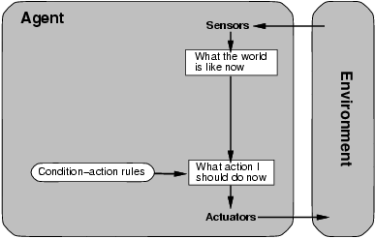
Simple reflex agents

Slide 36
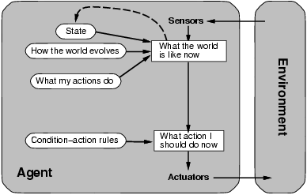
Model-based reflex agents

Slide 37
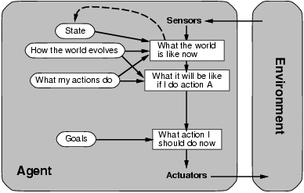
Goal-based agents

Slide 38
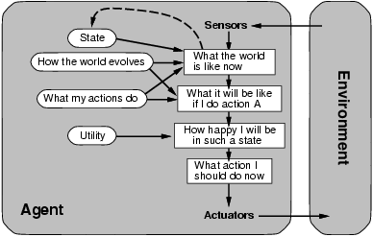
Utility-based agents

Slide 39
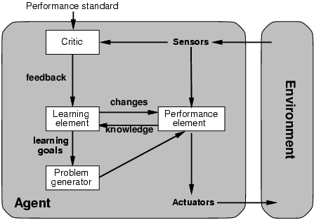
Learning agents

